Slide 1

Project Topic:-
Room Rental Services
Online project based
on Python with django
Notes:
oo

Slide 2
Introduction of Project
It is a platform to book room’s online from home.
Users can check availability for room from home.
User’s and admin manage there password and profile.
Admin manage User to book room’s, view room’s, and book them.
We are using HTML, CSS, Bootstrap and JS for front-end design.
Django use for backend in this project.
SqLite database used in this project.

Slide 3
Minimum Software and Hardware Specification:-
Pentium IV Processor
512 MB RAM
40 GB HDD
Color Monitor
Keyboard, Mouse
Python installed
Any text editor (Pycharm, notepad++, etc.)
Django installed
Any Internet Browser

Slide 4
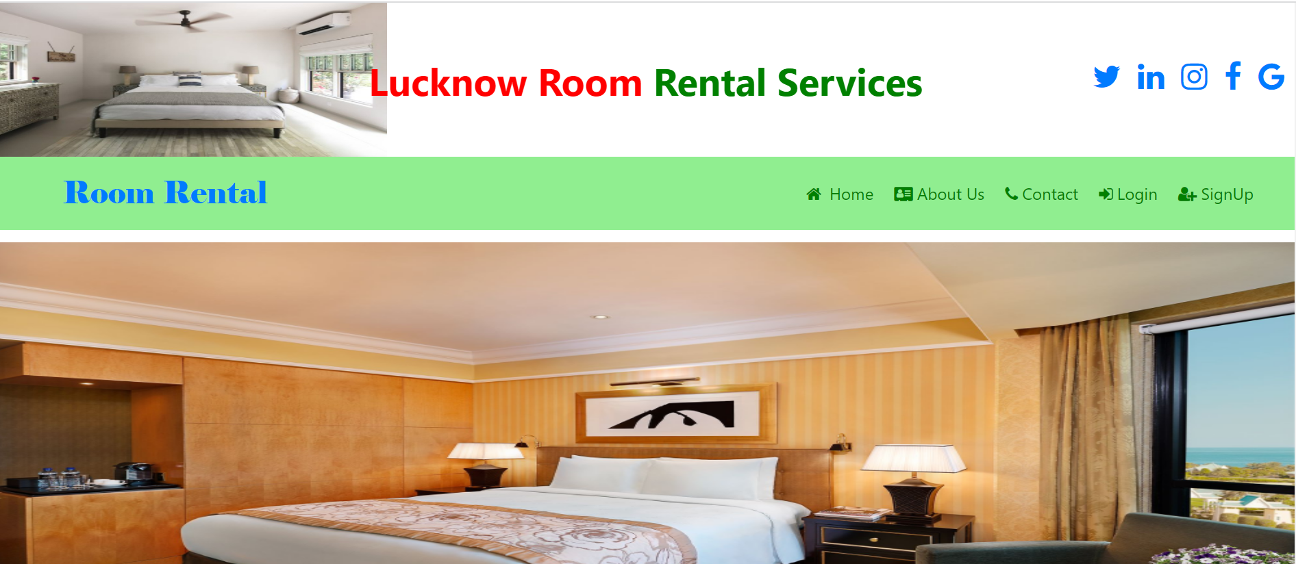
Home Window Of the Project:-

Slide 5
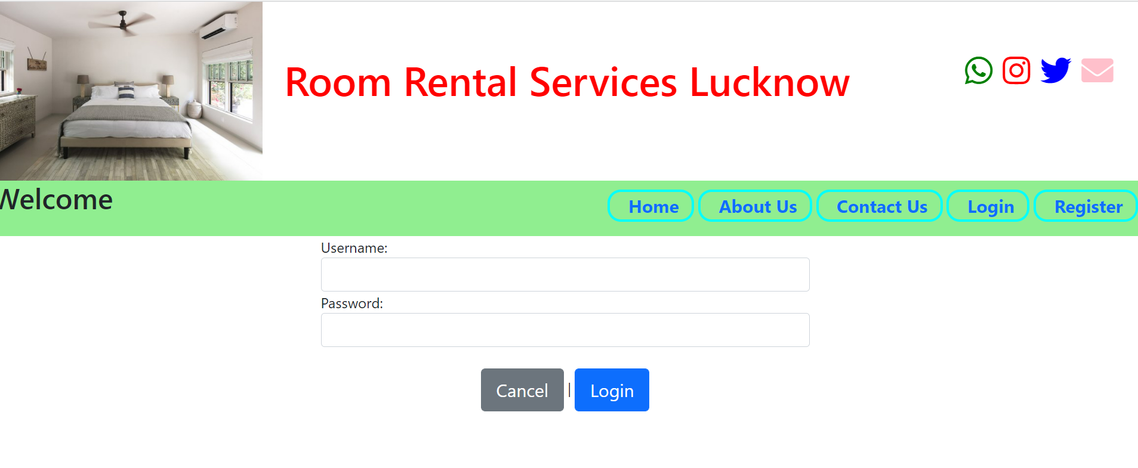
Login Window Of the Project:-

Slide 6
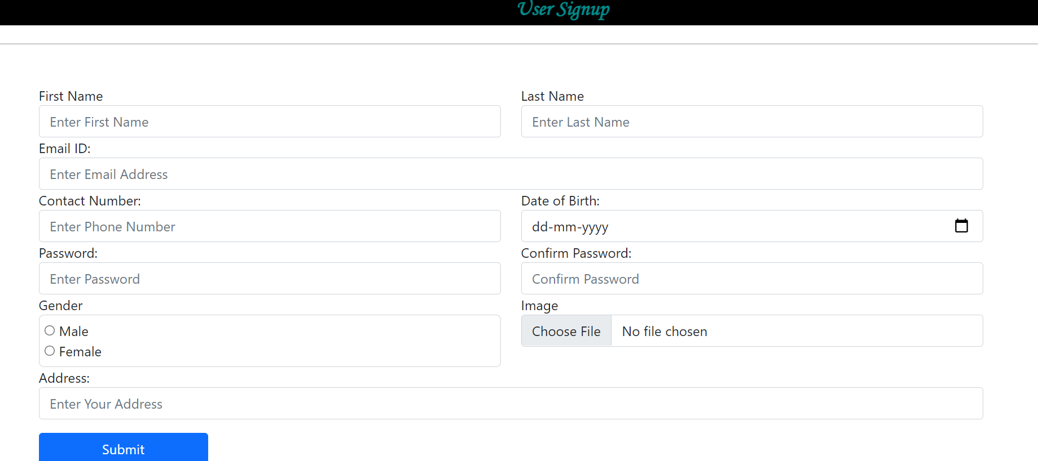
Signup Window Of the Project:-

Slide 7
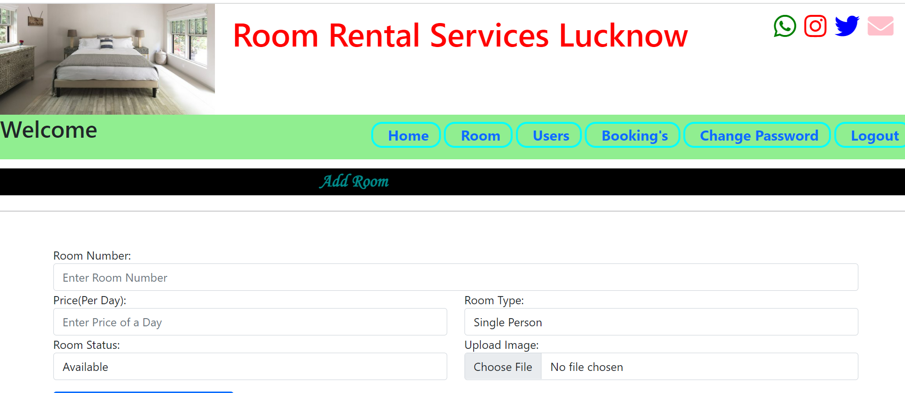
ADD ROOM PAGE :-

Slide 8
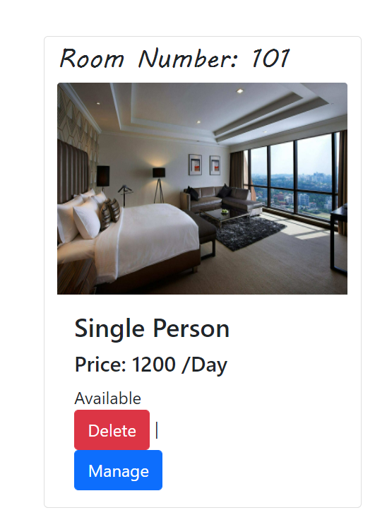
View ROOM PAGE :-

Slide 9
Advantages:-
Easy to book room from home.
Book room at any time 24*7 hour.
Easy to check room status.
Easy to select type and days for room booking.
Cancel booking easily.
Add feedback about services and environment.
Signup process is easy.

Slide 10
Disadvantages:-
Must have to a system or mobile.
Internet connection required.
Connection may loss dew to network problem.
Screen may harmful for eyes.

Slide 11
Thank You

